Slide 1
Variable Length Subnet Mask (VLSM)

Slide 2
Variable Length Subnet Mask (VLSM) (1 of 3)
VLSM (Variable Length Subnet Mask) allows subnets to be further subdivided into smaller and smaller groupings until each subnet is about the same size as the necessary IP address space
This is often referred to as “subnetting a subnet”
To create VLSM subnets, you create the largest subnet first
Then, you create the next largest subnet, and the next one, and so on

Slide 3
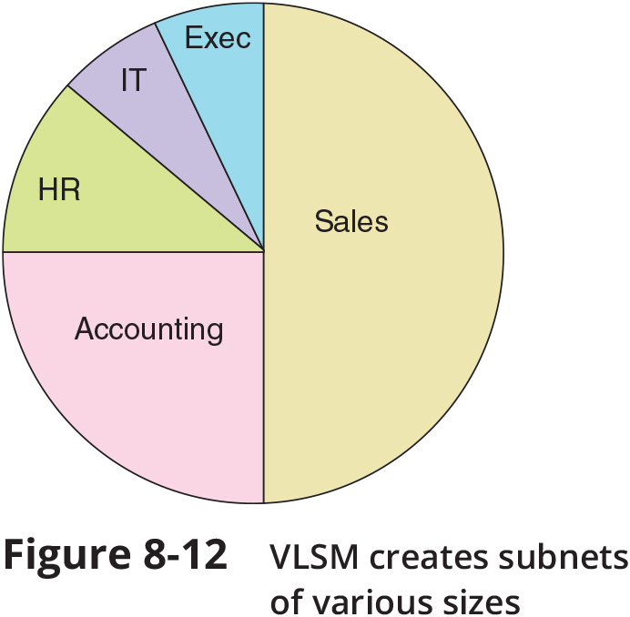
Variable Length Subnet Mask (VLSM) (2 of 3)

Slide 4
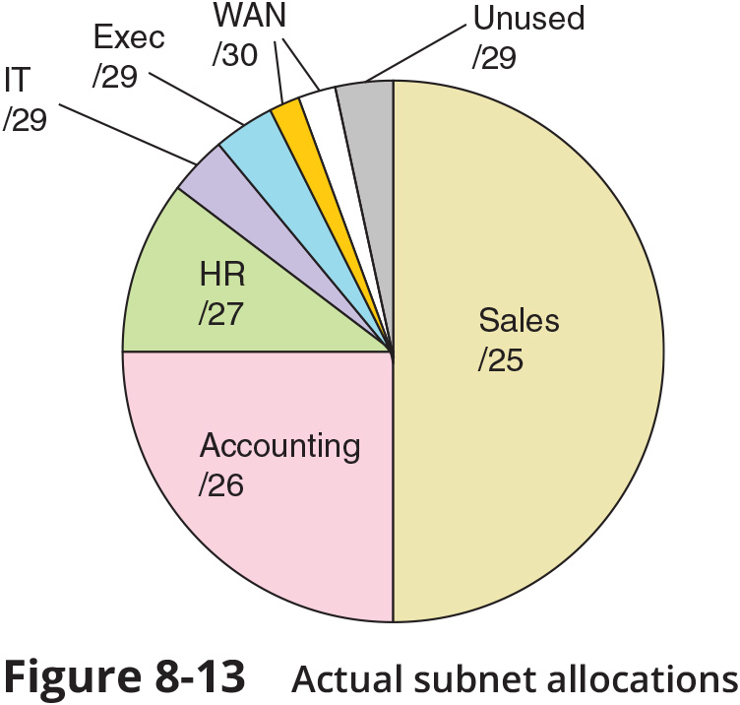
Variable Length Subnet Mask (VLSM) (3 of 3)

Slide 5
Subnets in IPv6 (1 of 3)
Subnetting in IPv6 is simpler than IPv4 in the following ways:
IPv6 addressing uses no classes
IPv6 does not use subnet masks
A single IPv6 subnet can supply 18,446,744,073,709,551,616 IPv6 addresses
Subnetting helps administrators manage the enormous volume of IPv6 addresses

Slide 6
Subnets in IPv6 (1 of 3)
An IPv6 address is commonly written as eight blocks of four hexadecimal characters and divided in the following ways:
The last four blocks identify the interface
The first four blocks identify the network and serve as the network prefix (also called the site prefix or global routing prefix)
The fourth hexadecimal block in the site prefix can be altered to create subnets

Slide 7
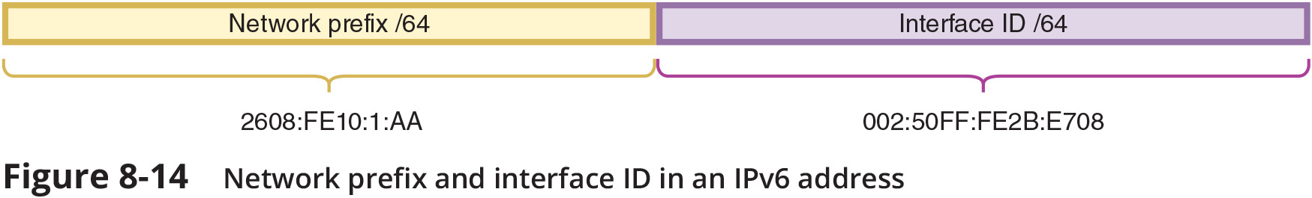
Subnets in IPv6 (2 of 3)

Slide 8
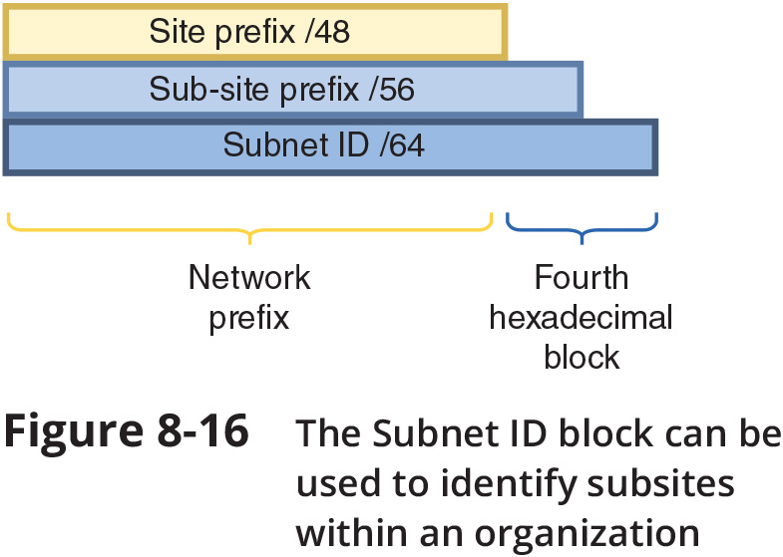
Subnets in IPv6 (3 of 3)

